Slide 1
Life can be complicated. Getting your medications doesn’t have to be.
Life can be complicated.
Getting your medications
doesn’t have to be.

Slide 2
Can’t stop by?
Genoa Healthcare’s on-site pharmacy can mail your medications at no additional cost.

Slide 3
We’ll save you some stops.
Genoa Healthcare’s on-site
pharmacy can fill all medications.

Slide 4
Let’s keep you on track.
Genoa Healthcare’s pre-filled pill organizer helps you take the right
dose at the right time.

Slide 5
Our on-site pharmacy accepts most major insurances, including Medicare and Medicaid.
Care that’s customized.

Slide 6
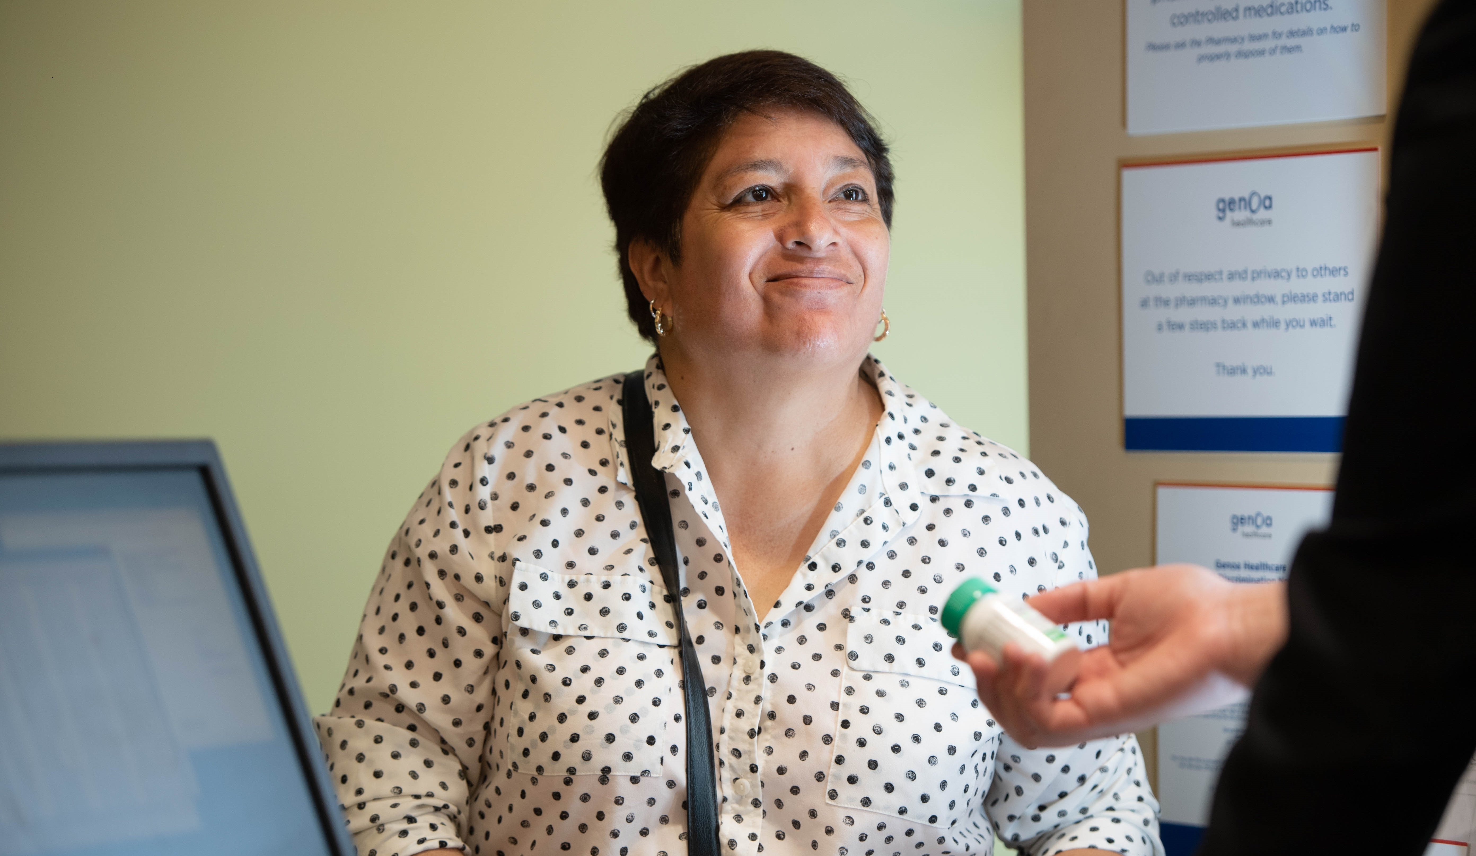
Your questions. Our answers.
Stop by Genoa Healthcare’s on-site pharmacy to learn more.

Slide 7
Genoa Healthcare® [Address] Phone: (000) 000-0000 Fax: (000) 000-0000 Hours: Monday-Friday: 0am-0pm Closed for Lunch: 0pm-0pm

